Slide 1

Multi-agent pathfinding
Nina Dobša, Vittorio Vičević

Slide 2
Agenda
Motivation
MAPF problem
Solution code
Results
Comparison with different model
Conclusion

Slide 3
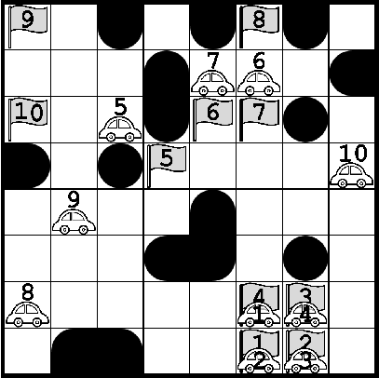
motivation – REAL LIFE USAGE
Robotics and Autonomous Vehicles
Computer games
Manufacturing and logistics
Emergency Response and Disaster Management
Warehouse automation

Slide 4
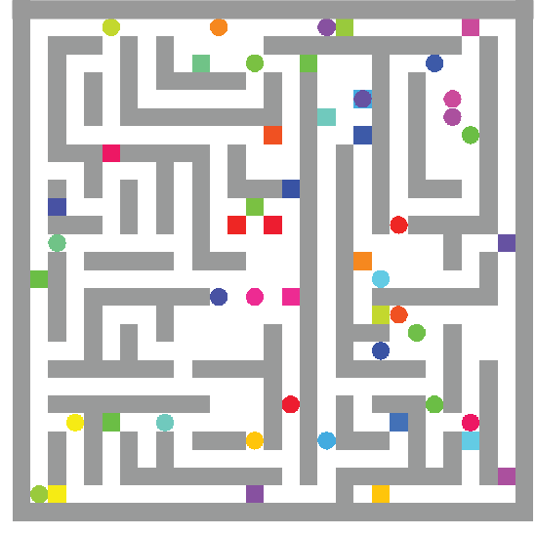
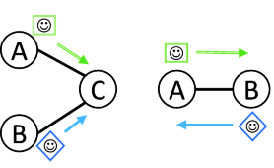
MAPF problem
GOAL : Compute collision-free paths for agents from their start locations to given destinations
CONSTRAINTS:
Each agent can perform one step at a time
Collisions forbidden:
vertex conflict
swap conflict
OBJECTIVE: Minimize Makespan (the number of time steps required for all agents to reach their target)

Slide 5
solution code - Variables
Variables:
N = Grid size (NxN)
numAgents = Number of agents Python code generates random instances
array [1…numAgents] starts = Agents’ starting positions (N ∈ [10, 50], numAgents ∈ [5, 20])
array [1…numAgents] targets = Agent’s target positions
maxT = Maximum number of timesteps
Decision Variables:
array[1..maxT, 1..numAgents] position = Position of each agent at each timestep

Slide 6
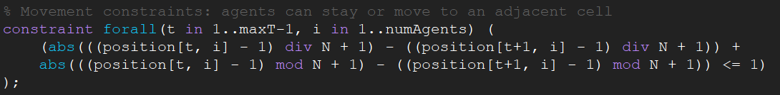
Solution code - Constraints
Initial and ending positions
positions[1,a] = starts[a] AND position[maxT, a] = targets[a] for a ∈ {1, …, numAgents}
Movement (one step up / down / left / right at a time)

Slide 7
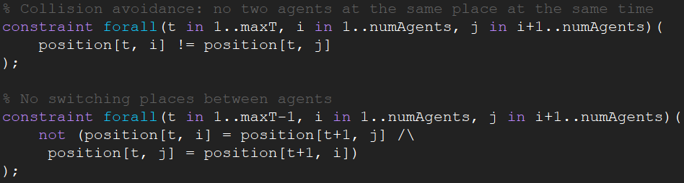
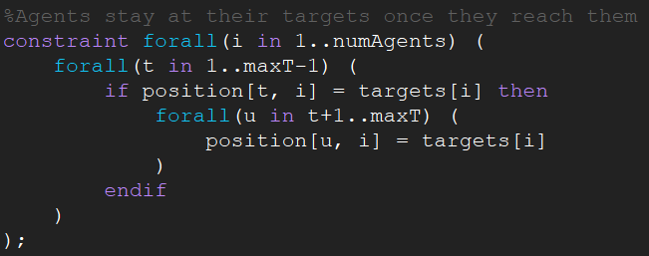
Solution code - Constraints
Collision
Staying at place after reaching the target value

Slide 8
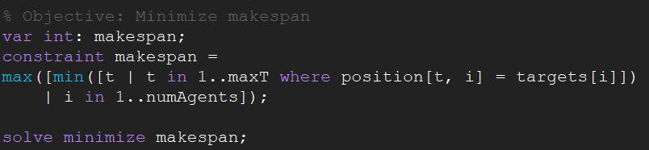
Solution code - Objective
getting optimal solution -> minimization of makespan
makespan = maximum out of all minimum time steps needed for each agent to reach their target

Slide 9
Results
Testing with MiniZinc IDE
Best performance - ’Gurobi’ solver
Running time depends on grid size and number of agents
ex. Small grid size (10-20)
Test | N | numAgents | Time | Optimum moves
1 | 14 | 7 | 6 sec | 17
2 | 17 | 8 | 17 sec | 19
3 | 18 | 20 | > 10 min | NA

Slide 10
Results
ex Medium grid size (20-35)
ex. Big grid size
N = 50, numAgents = 14 -> Time = 25 min
Test | N | numAgents | Time | Optimum moves
1 | 28 | 5 | 8 sec | 27
2 | 26 | 10 | 3 min | 28
3 | 23 | 11 | 2 min | 30

Slide 11
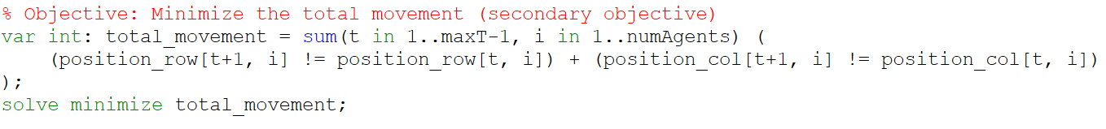
Comparison with different model
Objective: minimizing the total movement
Optimal results with longer running time

Slide 12
conclusion
Running time depends mostly on number of agents and also on grid size
In all cases (N ∈ [10, 50], numAgents ∈ [5, 20]) running time was under 25 min
Gurobi solver performed the best in this example

Slide 13
thank you for your attention!

